Slide 1
Context Free Grammars
CFGs
  Add recursion to regular expressions
    Nested constructions
  Notation
    expression → identifier | number | - expression
    | ( expression )
    | expression operator expression
    operator → + | - | * | /
    Terminal symbols
    Non-terminal symbols
    Production rule (i.e. substitution rule)
      terminal symbol → terminal and non-terminal symbols

Slide 2
Backus-Naur Form
Backus-Naur Form (BNF)
  Equivalent to CFGs in power
  CFG
    expression → identifier | number | - expression
    | ( expression )
    | expression operator expression
    operator → + | - | * | /
  BNF
    ⟨expression⟩ → ⟨identifier⟩ | ⟨number⟩ | - ⟨expression⟩
    | ( ⟨expression⟩ )
    | ⟨expression⟩ ⟨operator⟩ ⟨expression⟩
    ⟨operator⟩ → + | - | * | /

Slide 3
Extended Backus-Naur Form
Extended Backus-Naur Form (EBNF)
  Adds some convenient symbols
    Union |
    Kleene star *
    Meta-level parentheses ( )
  It has the same expressive power

Slide 4
Extended Backus-Naur Form
Extended Backus-Naur Form (EBNF)
  It has the same expressive power
  BNF
  ⟨digit⟩ → 0
  ⟨digit⟩ → 1
  …
  ⟨digit⟩ → 9
  ⟨unsigned_integer⟩ → ⟨digit⟩
  ⟨unsigned_integer⟩ → ⟨digit⟩ ⟨unsigned_integer⟩
  EBNF
  ⟨digit⟩ → 0 | 1 | 2 | 3 | 4 | 5 | 6 | 7 | 8 | 9
  ⟨unsigned_integer⟩ → ⟨digit⟩ ⟨digit⟩*

Slide 5
Derivations
A derivation shows how to generate a syntactically valid string
  Given a CFG
  Example:
    CFG
    expression → identifier | number | - expression
    | ( expression )
    | expression operator expression
    operator → + | - | * | /
    Derivation of
    slope * x + intercept

Slide 6
Derivation Example
Derivation of slope * x + intercept
    expression ⇒ expression operator expression
    ⇒ expression operator intercept
    ⇒ expression + intercept
    ⇒ expression operator expression + intercept
    ⇒ expression operator x + intercept
    ⇒ expression * x + intercept
    ⇒ slope * x + intercept
    expression ⇒* slope * x + intercept
    Identifiers were not derived for simplicity
Notes:
⇒ metasymbol: replacement of some non-terminal
Result: yield of derivation
Right-most derivation

Slide 7
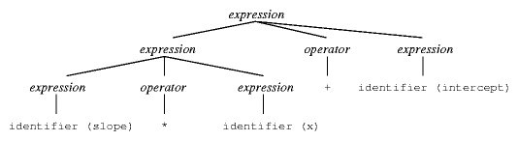
Parse Trees
A parse is graphical representation of a derivation
Example
Notes:
Right-most derivation

Slide 8
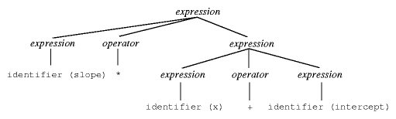
Ambiguous Grammars
Alternative parse tree
  same expression
  same grammar
This grammar is ambiguous
Notes:
Left-most derivation

Slide 9
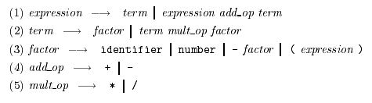
Designing unambiguous grammars
Specify more grammatical structure
  In our example, left associativity and operator precedence
    10 – 4 – 3 means (10 – 4) – 3
    3 + 4 * 5 means 3 + (4 * 5)

Slide 10
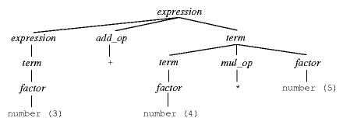
Example
Parse tree for 3 + 4 * 5
Exercise: parse tree for
    - 10 / 5 * 8 – 4 - 5

